Slide 1
CT026-3.5-2
Human Computer Interaction
Human Computer Interaction
Usability & Usability Engineering
Level 2
Prepared by: RHR First Prepared on: December, 2007 Last Modified on:
Quality checked by: MOH
Copyright 2004 Asia Pacific Institute of Information Technology

Slide 2
Topic & Structure of the lesson
Usability Engineering
Five usability attributes
Usability Engineering lifecycle

Slide 3
Learning Outcomes
At the end of this lecture, you should be able to:
  Define the term “Usability Engineering”
  Describe the various steps involved in Usability Engineering Lifecycle
  Apply Usability Engineering Lifecycle in designing any system or application

Slide 4
Key Terms you must be able to use
If you have mastered this topic, you should be able to use the following terms correctly in your assignments and exams:
Usability engineering
Usability lifecycle
Usability goals

Slide 5
Usability
“Usability: the extent to which a product can be used by specified users to achieve specified goals with effectiveness, efficiency and satisfaction in a specified context of use.”

Slide 6
Usability
Why is usability important?
  It makes the difference between performing a task accurately and completely or not, and enjoying the process or being frustrated.
  Determine the success or failure of a system
Poor usability…
  Reduce productivity
  Increase cost, time and effort

Slide 7
Usability
Usability usually refers to software but is relevant to any product. Some ways to improve usability include:
  shortening the time to accomplish tasks,
  reducing the number of mistakes made,
  reducing learning time,
  and improving people's satisfaction with a system.

Slide 8
Usability
According to Jakob Nielsen (2003), usability is
defined by 5 quality components :
Learnability : ease of learning for novice users.
Efficiency : steady-state performance of expert users.
Memorability : ease of using system intermittently for casual users.
Errors : error rate for minor and catastrophic errors.
Subjective Satisfaction : how pleasant the system is to use.

Slide 9
Learnability - are been look at how easy a system is to be learn to use for the first time.
  This goals aim is to ensure how easy the system is and how long does it take to get started using a system to perform core tasks and to learn the range of operations to perform a wider set of tasks?
Errors - Referring to the contexts of avoid user to be in undesirable condition or situation when performing a particular tasks.
  Helping user to avoid any kind of doing unwanted action accidentally
  Example : arrangement of the button can reduce the risk of user mistakenly activate wrong keys while performing certain actions. Such as don’t place the delete button next to the safe button on a menu.
Efficiency - Referring to the way a system supports user in carrying out their tasks.
  Once the user have learned on how to user a system in carrying out their tasks can they sustain a high level on productivity
  Example – e-commerce site
Memorability - Referring of how easy a system is to remember / recall how to user once learned.
  The user should be able to remember or at least rapidly be reminded on how to use or perform certain operation that haven’t be used for a few months

Slide 10
Learning Curves
Some systems are designed to focus on learnability.
Others emphasise efficiency for proficient users.
Some support a combination of ease of learning and an “expert mode” (for example rich menus and dialogues plus a command/ scripting language)

Slide 11
Domain & Expertise
Knowledgeable About the Domain
Expert User Of System
Minimal Computer Experience
Extensive Computer Experience
Novice User of the System
Ignorant About the Domain

Slide 12
Relationship between Usability Goals and User Types
Novice Users:
  No or limited knowledge of the occupational task to be performed, and of computers and interface concepts or
  Knowledge of the occupational task to be performed, and of computers and interface concepts

Slide 13
Relationship between Usability Goals and User Types
Knowledgeable Intermittent Users:
  Understanding of the task concepts
  Broad knowledge of computers and interface concepts.
  Intermittently use the system and may therefore have problems with retention
Expert Frequent (Power) Users:
  Thoroughly familiar with both task and interface concepts. They are likely to use the system often and appreciate short cuts to speed their work.

Slide 14
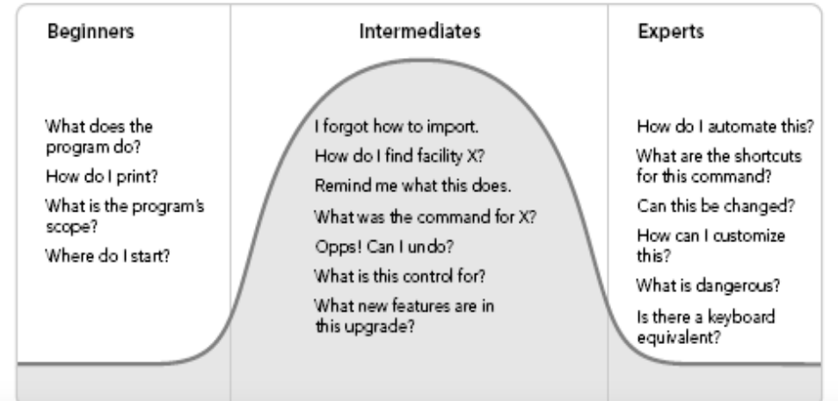
User Types Cont..

Slide 15
Typical Ways of Measuring Usability
Learnability: pick novice users of system, measure time to perform certain tasks.
Distinguish between the various timings taken for some general computer experience.

Slide 16
Typical Ways of Measuring Usability
Efficiency : decide definition of expertise, get sample expert users (which tends to be difficult), measure time taken to perform typical tasks.

Slide 17
Typical Ways of Measuring Usability
Memorability : get sample casual users (who are usually away from system for certain time/duration) and measure time to perform typical tasks.

Slide 18
Typical Ways of Measuring Usability
Errors : count minor and catastrophic errors made by users while performing some specified task.

Slide 19
Typical Ways of Measuring Usability
Satisfaction : ask users subjective opinion (questionnaire, interview), after trying system for real task.

Slide 20
Usability Engineering
The term usability engineering describes a process of user interface development, sometimes referred to as user centred design.
It is a lifecycle process that puts an early emphasis on user and task analysis and actual user involvement in the design and testing of a product.
A product developed with such a user centred process is likely to be a more usable product than one that is developed independent of user considerations and involvement.

Slide 21
Usability Engineering Lifecycle
Users, Tasks, Environment Analysis
Usability Goals , Competitive Analysis
Parallel Design Sketches
Participatory Design
First Prototype
Iterative Design
Formative Testing
Final Released Product

Slide 22
Usability Engineering Lifecycle
Identify user requirements and problems
  Profile Users
  Task Analysis
Identify usability goals based on user requirements and checkout similar products
Parallel Design
Participatory Design
Prototype a solution
Evaluate prototype
  Usability testing (real users and real tasks)
Reiterate steps 4-5 …until users are satisfied

Slide 23
Usability Engineering Lifecycle
Identify user requirements and problems:
  Define your user population.
  Determine the distribution of skills, knowledge and experience within your user population.
  Assess the user’s skill level with respect to both the task and computer domain.

Slide 24
Usability Engineering Lifecycle
Identify user requirements and problems:
  Typical Profile:
    40 % Novice Users
    57 % Knowledgeable/Intermittent Users
    3 % Expert Users
  Other Important Information:
    10 % of user population colour blind
    15 % are the elderly

Slide 25
Usability Engineering Lifecycle
Identify user requirements and problems:
  Task analysis allows a designer to identify the goals and purposes of the intended user group.
  This used to involve further analysis of user requirements or investigation/observation of customers
  Used to guide user interface design

Slide 26
Usability Engineering Lifecycle
Identify usability goals based
  Learnability, Efficiency, Memorability, Error, Subjective Satisfaction
  Decide in advance on usability metrics and desired level of measured usability
  E.g.
Errors Per Hour
Optimal | Target | Current | Unacceptable
0 | 1 - 3 | 4.5 | > 5

Slide 27
Usability Engineering Lifecycle
Check out similar products (Competitive Analysis)
  Competitive analysis of software components
  Competitive analysis of competing systems

Slide 28
Usability Engineering Lifecycle
Parallel Design (Explore design alternatives)
  designers should work independently, then compare draft designs

Slide 29
Usability Engineering Lifecycle
Participatory Design
  Have access to pool of representative users.
  Guided discussion of prototypes, paper mock-ups, screen designs with representative users.
  E.g. Card Sorting

Slide 30
Usability Engineering Lifecycle
Applying Guidelines
  Guidelines . . . general principles and advice about usability characteristics of interfaces
  Can be intimidating – often hundreds or thousands of specific recommendations.

Slide 31
Usability Engineering Lifecycle
Prototyping & Testing
Perform usability evaluation as early as possible in the design cycle by building and evaluating prototypes

Slide 32
Learning Outcomes revisited
Check yourself to see if you can now:
  Define the term “Usability Engineering”
  Describe the various steps involved in Usability Engineering Lifecycle
  Apply Usability Engineering Lifecycle in designing any system or application

Slide 33
Question and Answer Session
Q & A

Slide 34
Next Session
Topic and Structure of next session
User Profiling
Notes:
Can proceed with the tutorial, get student to come back to the next class (during tutorial slot) to present their vending machine product

